Slide 1
Valley of the Moon Water District Local Hazard Mitigation Plan + + +
Hazard Mitigation Planning Committee Meeting #1
Valley of the Moon Water District
19039 Bay Street
Sonoma, CA 95476
June 25, 2020

Slide 2
Agenda
Introductions
Mitigation Planning and the Disaster Mitigation Act
Planning Process
Role of the Hazard Mitigation Planning Committee (HMPC)
Hazard Review
Community Engagement Strategy
Data Collection Guide
Schedule
Questions
Notes:
What we will talk about today.

Slide 3
Introductions

Slide 4
Introductions
Valley of the Moon Water District
Christopher Petlock
Project Manager
Wood Environment & Infrastructure Solutions, Inc.
Jeff Brislawn, CFM
Hazard Mitigation Lead
Juliana Prosperi, AICP
Project Manager
Notes:
Start with introductions, but asking the group to state their name, the jurisdiction or department they represent, their role at the jurisdiction/department, and whether they have participated in a similar hazard mitigation planning process in the past.

Slide 5
Mitigation Planning and the Disaster Mitigation Act

Slide 6
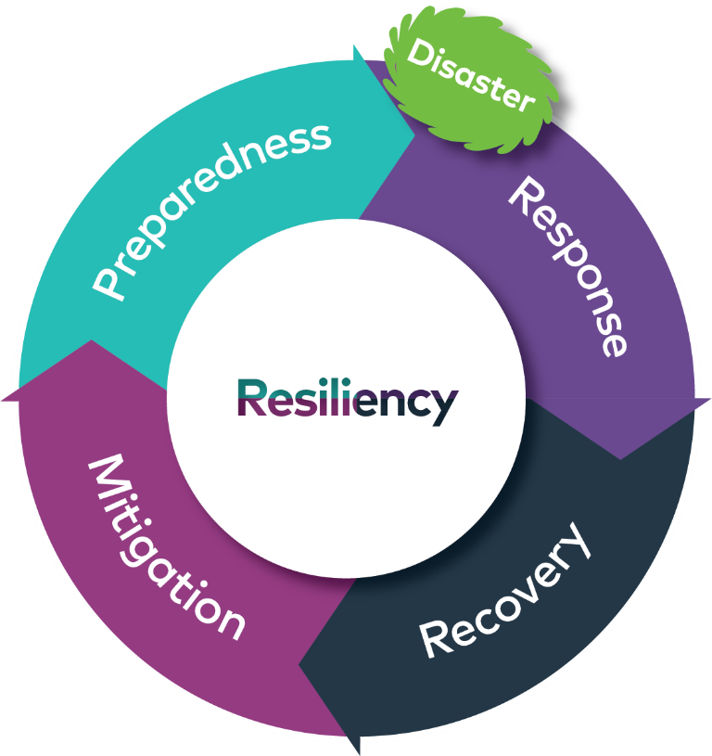
Mitigation Planning and Disaster Mitigation Act
What is Hazard Mitigation?
Any sustained action taken to reduce or eliminate long-term risk to human life and property from natural and human-caused hazards.
Notes:
Hazard Mitigation: Any sustained action taken to reduce or eliminate long-term risk to human life and property from natural and human-caused hazards
Straightforward examples include strengthening buildings, elevating flood-prone structures, maintaining defensible space, and limiting development in floodplains
The District is no strangers to natural disasters, and this larger community is still “recovering” from the 2017 and 2019 wildfires. Each time we experience these events, we learn how to make our people, infrastructure, and environment more resilient. These events underscore the need to assess and manage risk.
Historically, the response-recovery and repeated damage cycle prevailed, which looks a lot like the graphic shown, but without the “mitigation” or “preparedness” links, which involve important capacity building and pre-impact actions communities can take to minimize disaster recovery efforts, environmental and economic impacts, and reconstruction costs.
By shifting towards “mitigation” the Valley of the Moon Water District can break this cycle and reduce losses after a disaster.

Slide 7
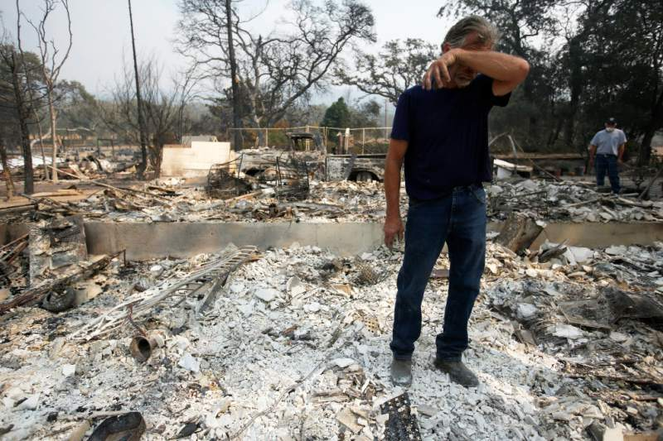
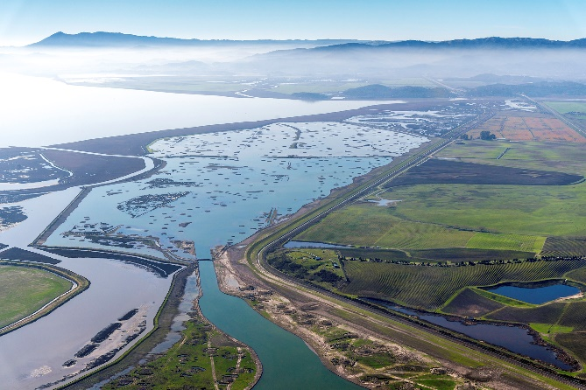
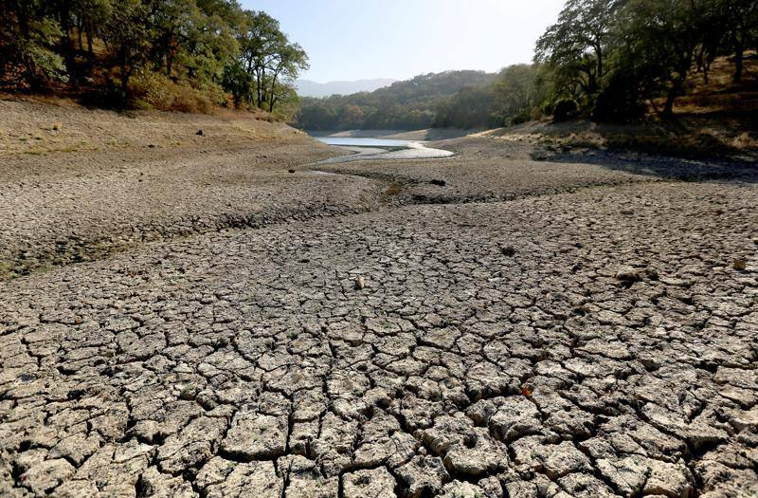
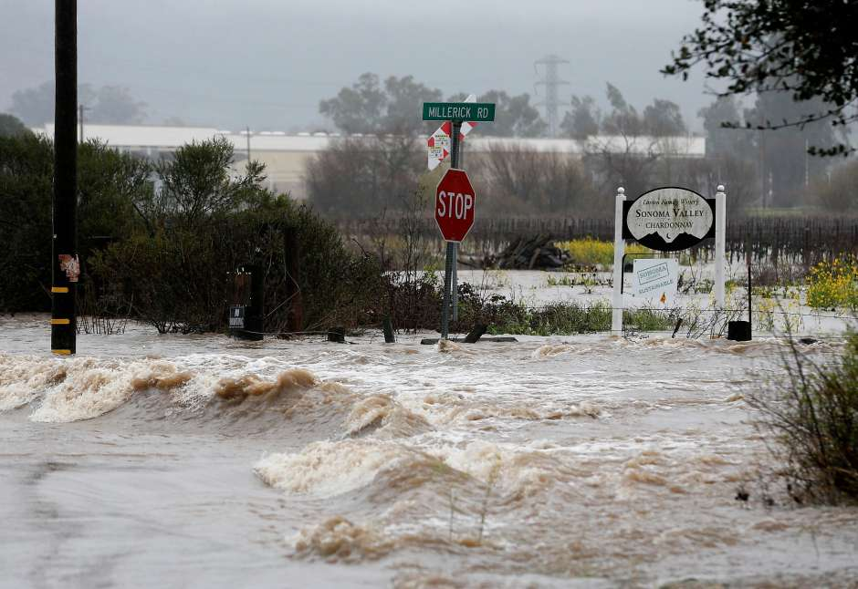
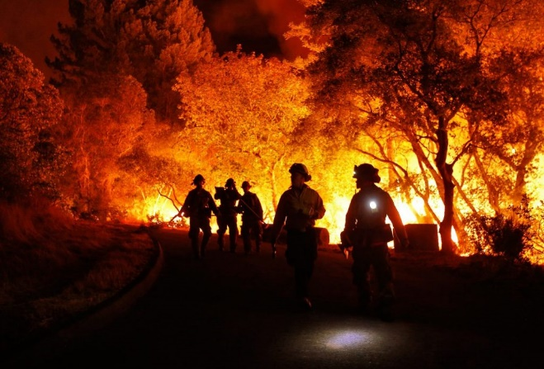
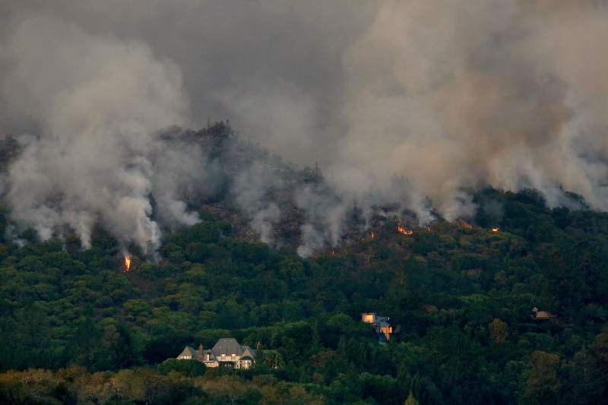
Recent Natural Disasters around Sonoma Valley
“Every dollar invested on disaster prevention saves six dollars in costs related to response and recovery.” -National Institute of Building Science
Notes:
Top Left – Nuns Fire destroyed approximately 54,000 acres, including 34,398 acres in Sonoma County. Home in Glen Ellen, CA impacted during these 2017 fires after they swept through the region.
Middle – San Pablo Bay from above, consideration of the effects of sea level rise on tidally-influenced waterways in Sonoma Valley
Top Right – Suttonfield Lake above Sonoma Developmental Center in Glen Ellen; during 2014 drought there were concerns lake could dry out if SDC water treatment plant is not in operation – question is will there be water supplies after an earthquake? Do we need a back-up plan? More redundancy in water system?
Bottom left – flooding along Sonoma Creek in 2017 closed schools
Middle – Continual and more frequent risk of wildfires
Bottom right – flames from the Southern Complex fire in 2017 as it creeps downhill towards homes overlooking the Kenwood vineyards.
According to a report by the National Institute of Building Sciences, “it is estimated that for every $1 invested in hazard mitigation, an average of $6 is saved in the long-term.”
This fact emphasizes why the Valley of the Moon Water District is excited to prepare their first LHMP. It is the first detailed look at the District’s hazards and a “living plan” to track their mitigation projects and reduce their risks to a range of hazards that can impact the District.

Slide 8
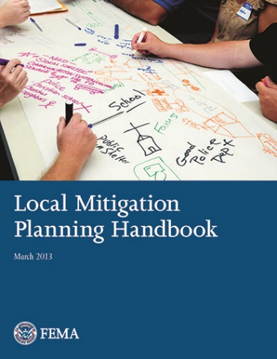
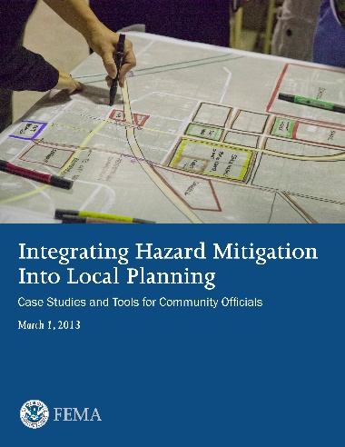
Disaster Mitigation Act of 2000
Federal Legislation
44 CFR 201.6
Requires communities to update their hazard mitigation plans every 5 years to remain eligible for federal pre- and post-disaster funding (Hazard Mitigation Grant Program)
Plan ensures the District will be ready and eligible for mitigation projects when funding becomes available
Notes:
What is the federal regulatory context driving the need for these plans?
At a federal level, they are mandated by the Disaster Mitigation Act of 2000, which sole purpose was to reduce the loss of life and property and economic disruption resulting from natural disasters.
The requirements of the law summarized in the Code of Federal Regulations (44 CFR 201.6); this District’s LHMP will reference these federal regulations and legal requirements in the beginning of each chapter.
The Act requires communities to prepare and update their LHMPs every 5 years to remain eligible for federal disaster funding through the Hazard Mitigation Grant Program.
In other words, a LHMP will ensure the District remains eligible for reimbursement after federally declared disasters.

Slide 9
Mitigation Planning and Disaster Mitigation Act
Trends Resulting in Increased Costs for Disaster Response and Recovery
Population and community growth
More people
More infrastructure and buildings
More exposure to risk
More natural and human-caused hazards
Technological, civil, terrorist hazards
Human-health hazards (pandemics)
More disaster declarations
Increase in disaster response and recovery costs
Costs $$
Hazards
Notes:
What is changing in California and Sonoma Valley? What is driving the need for these plans besides the legal requirements?
The trends associated with increased costs associated with disaster response, particularly here in California is there is more people and more structures across the state
There are also more natural and human-caused hazards impacting our families and businesses; this is evident right now given the recent shelter-in-place orders in the State of California.
There are also more disaster declarations each year, and in turn increased response costs.

Slide 10
Mitigation Planning and Disaster Mitigation Act
Why do we need a Local Hazard Mitigation Plan?
Increasing costs of response and recovery
Many events are predictable and repetitive
Prevents loss of life and injury and protects public safety
Guides mitigation activities in a coordinated and economic manner
Eligibility for mitigation funds, pre- and post- disaster
Integrates into other existing planning mechanisms
2016 Sonoma County Operational Area HMP
2018 Sonoma Water LHMP
Reduces risk to existing and future development
Make community safer and more disaster resilient
Notes:
So, why plan?
As I mentioned earlier “mitigation planning” shifts the District closer towards breaking this cycle associated with high costs of response-recovery.
These plans prepare communities and prevent loss of life and protect public safety. In other words, they make the District prepared and proactive!
LHMPs guide mitigation activities in a coordinated manner, and in a transparent way the District can track and share successes with the public.
Enables the District to be eligible for pre- and post-disaster funding, and when updated, keeps the District eligible!
LHMPs integrate other existing planning mechanisms or tools like the General Plan, County HMP, County EOP, Cal Fire Plan, and establish opportunities for overlap between plans - working with sister agencies in your jurisdiction will maximize the usefulness of your document.
They reduce the risk to existing and future development.
Set’s the course for response and recover to impacts from natural disasters
Requires commitment and support from elected officials and their constituents
Most importantly, these plans make the community safer and build resiliency.

Slide 11
Planning Process

Slide 12
FEMA’s 4-Phase DMA Planning Guidance
Determine the planning area and resources
Build the planning team (Hazard Mitigation Planning Committee)
Review community capabilities
Create an outreach strategy
Phase I
Conduct a risk assessment
Develop mitigation strategies
Keep the plan current
Review and adopt the plan
Create a safe and resilient community
Phase II
Phase III
Phase IV
Notes:
Originally, FEMA organized the planning process into 4 steps:
Organize Resources – so build a planning team, stakeholders, and understand community capabilities
Risk Assessment – to determine potential impacts of hazards to the people, economy, and built and natural environments of the community. Provides foundation for the rest of the mitigation planning process.
Mitigation Plan or “Strategy” – heart of the plan because it serves as the long-term blueprint for reducing the potential losses identified in the risk assessment. It describes how the community will accomplish the mission of the planning process. It includes three main and required components: goals, actions, and an action plan for implementation.
Adoption and Implementation – incorporating feedback from the planning team, stakeholders, and the public on the final plan document. This step also involves keeping the plan current by maintaining the plan and tracking implementation of the plan over time.

Slide 13
CRS 10-Step Process and the 4-Phase Guidance
Phase I: Organize Resources
Get organized
Plan for public involvement
Coordinate with other departments and agencies
Phase II: Risk Assessment
Identify the hazard(s)
Assess the risks
Phase III: Develop a mitigation plan
Set planning goals
Review mitigation alternatives
Draft and action plan
Phase IV: Adoption and Implementation
Adopt the plan
Implement the plan, evaluate its worth, and revise as needed
Notes:
During the planning process, we reference a more detailed 10-step planning process used for FEMA’s Community Rating System (CRS) participants and the Flood Mitigation Assistance program is integrated.
For this application, the modified 10- step process used for this plan meets the requirements of five major programs: FEMA’s Hazard Mitigation Grant Program, Pre-Disaster Mitigation program, Community Rating System, Flood Mitigation Assistance Program, and new flood control projects authorized by the U.S. Army Corps of Engineers.

Slide 14
FEMA’s 2013 Nine-Step Process
Step 1 Determine the Planning Area and Resources
Step 2 Build the Planning Team
Step 3 Create an Outreach Strategy
Step 4 Review Community Capabilities
Step 5 Conduct a Risk Assessment
Step 6 Develop a Mitigation Strategy
Step 7 Keep the Plan Current
Step 8 Review and Adopt the Plan
Step 9 Create a Safe and Resilient Community
Notes:
FEMA updated their steps in their 4-phase planning process in 2013, so this planning process breaks down those steps in a slightly different process than the previous slide on the CRS steps.

Slide 15
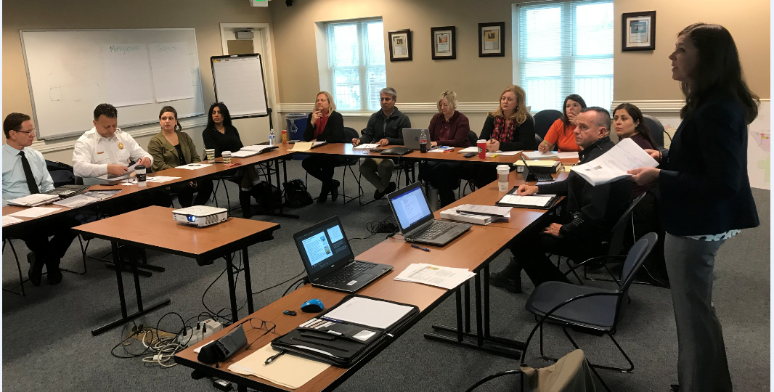
Phase I: Organize Resources
Get organized
Plan for public involvement
Coordinate with other department and agencies
Notes:
What is the planning area?
What are our resources?
Partnerships, stakeholders, planning team members for HMPC?
Establish a HMPC or reconvene HMPC if an update.
Partner with agencies involved in hazard mitigation activities, like the building department, planning department, public works, and with authorities to regulate development.
Engage your local leaders, promote participation, and then get buy-in
In Summary,
Obtain community commitment to mitigation
Determine and assign staff
Establish your mitigation planning team

Slide 16
1) Get Organized – Establish the HMPC
Valley of the Moon Water District Departments
District Manager
Operations Manager
Administration Manager
Board of Directors
Valley of the Moon Water District HMPC Meeting #1

Slide 17
2) Plan for Public Involvement
Requirement: Provide Two Opportunities
During drafting stage
Prior to approval
Include “public stakeholder” on planning team
Public Workshop/Open House
Community Engagement Strategy
Questionnaires/surveys
Post Draft LHMP online for comment prior to finalization
Document process for 2020/2021 in plan
Notes:
Advantages:
Solutions fit local needs better
Strengthens local support for plan
Special interests are considered; avoids being “Blind-Sided”
It is a fair process
Generates new ideas

Slide 18
3) Coordinate with Other Stakeholder Departments & Agencies
Sonoma County
Fire and Emergency Services Department
Office of Recovery and Resiliency
Department of Emergency Management
Sonoma County Transit
Sonoma County Water Agency
Pacific Gas & Electric
Federal, Regional, Businesses, Academia
Fairmont Sonoma Mission Inn
Sonoma Moto
Other Local Businesses
Cal Fire
CNRA
Cal OES
Neighboring Communities and Counties
City of Sonoma
FEMA Region IX
US Bureau of Reclamation
US Forest Service
National Oceanic Atmospheric Administration/National Weather Service
Sonoma Valley Unified School District
Health Care District
Sonoma Valley Hospital
La Luz Center
Sonoma Valley Fire & Rescue Authority

Slide 19
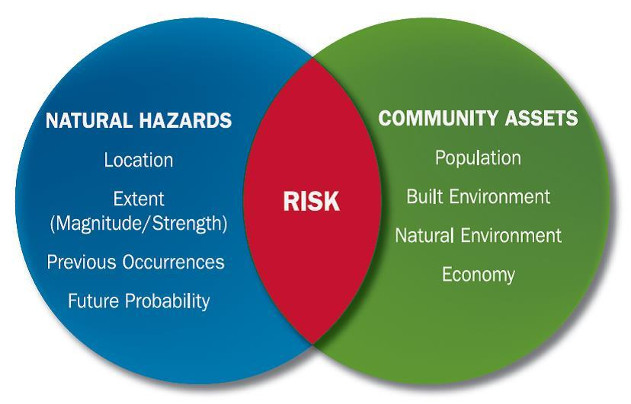
Phase II: Risk Assessment
Hazard Identification (what can happen here?)
Vulnerability Assessment (what will be affected?)
Critical Asset Inventory
Mitigation Capability Assessment
Notes:
The Risk Assessment identifies the hazards we will profile in the LHMP and determines the potential impacts of hazards to the people, economy, and built and natural environments of the community. This part of the plan asks,
What can happen here in Sonoma Valley?
What can happen that may affect the District’s critical infrastructure?
The Risk Assessment informs the “Mitigation Strategy” and establishes emergency preparedness and response priorities for land use planning.
Risks are the potential for damage, loss, or other impacts created by the interaction of natural hazards and community assets. This part of the plan summarizes the impacts created by the interaction of the natural hazards and District’s key assets
-Natural Hazards Circle (location, extent, magnitude, occurrences)
-Community Assets Circle (population, built environment)
-- overlap is the risk, so the smaller the overlap, the lower the risk.

Slide 20
4) Hazard Identification – Has It Happened Here Before?
Identify all possible hazards affecting the planning area
Profile the hazards
Information sources:
Past disaster declarations
Planning team / community members
Existing plans and reports
GIS-based maps and data
Internet websites and databases
Newspaper / historical records
Local, state, and federal experts
Insurance data
Notes:
How do we pull all this information together?
The top priority hazards you identified at the beginning of this Webinar are key! They provide our team with a starting point for understanding what hazards to evaluate in the plan, in addition to the obvious major hazards, such as earthquakes, flooding, and wildfires.
We use the best publicly available information and data sources to inform the Risk Assessment, and also any key District or Sonoma Valley specific studies.

Slide 21
Phase II: Risk Assessment
Hazard/Problem Description
Area, Seasonal Patterns, Speed of Onset/Duration
Geographic Location
Limited: Less than 10% of Planning Area
Significant: 10-50% of Planning Area
Extensive: 50-100% of Planning Area
Past Occurrences
Information on Historical Incidents, Known Impacts
Extent (Magnitude/Severity):
Catastrophic: More than 50% of property severely damaged
Critical: 25-50% of property severely damaged
Limited: 10-25% of property severely damaged
Negligible: Less than 10% of property severely damaged
Probability of Future Occurrences
Highly Likely: Near 100% chance of occurrence in next year
Likely: Between 10-100% chance of occurrence in next year
Occasional: Between 1-10% chance of occurrence in next year
Unlikely: Less than 1% chance of occurrence in next year
Significance
Low: Minimal potential impact
Medium: Moderate potential impact
High: Widespread potential impact
Notes:
The Risk Assessment is organized into the following 6 subsections:
hazard description – which defines the hazard and why it is a problem;
location - how much the hazard covers the planning area or service area
past occurrences – your historical list of events;
extent gets into the severity of the hazard (in other words – how much damage can/does it cause);
probability of occurrences - addresses the change of occurrence in the next year; and
significance is a qualitative summary that takes into account the previous five subsection discussions. In other words, a hazard that is located across more than 50% of the District’s service area and likely to damage more than 50% of the property here and has a high probability of occurring in the next year would have a High significance level.

Slide 22
Phase II: Risk Assessment
Climate Change Considerations
Increasingly important factor affecting disaster management
Addressed under each Hazard Profile as a factor intensifying impacts
California is already experiencing impacts:
Prolonged drought
Increased coastal flooding and erosion and sea level rise
Tree mortality
Larger wildfires
Affect the frequency and severity of hazards
Notes:
Climate change is an increasingly important factor affecting the disaster management cycle!
In the LHMP we address climate change under each hazard profile as a factor that can intensify impacts (low, medium, high)
California is already experiencing these impacts through prolonged drought, increased coastal flooding, sea level rise, tree mortality, and severe wildfires
In summary, climate change is affecting the frequency and severity of hazards.
How the frequency and severity of hazards is changing due to climate change?
1,800 more wildfires in 2015 than average (from SHMP)
Wildfires are now less predictable and more catastrophic
Occur outside of typical fire season
Larger conflagration sizes, more damaging
The most devasting effects of these wildfires happened here in Sonoma County and have impacted the District’s infrastructure.

Slide 23
5) Vulnerability Assessment – What Will Be Affected?
Inventory District-owned buildings and structures
Inventory critical facilities and infrastructure
Water Treatment Plants
Water Pipelines
Determine value of structures
Determine the number of people in hazard areas
Identify vulnerable infrastructure
Identify development trends / constraints
Identify historic, cultural, and natural resource areas
Estimate losses
Notes:
Vulnerability Assessment
After we profile the hazards, our team models what will be affected.
This assessment is based on a critical asset inventory and the District’s mitigation capabilities assessment.
Remember - the natural hazards circle includes the location, extent, magnitude and occurrence information; the community assets circle includes the population, built environment, and natural environment. This assessment gets into the community assets
Reminder from the earlier slide – the overlap area is the “risk.” and we want the overlap to be small, so we can lower the District’s risk.

Slide 24
Mitigation Capability Assessment
Inventory of the District’s existing and proposed policies, programs, and ordinances that may affect its vulnerability to hazards
Evaluate the effectiveness of each for mitigation purposes. Note gaps, shortfalls or conflicts associated with design, enforcement of implementation. Identify any special opportunities
Determine the District’s technical and fiscal abilities to implement mitigation initiatives. Include ability to attract and leverage funding
Notes:
We start by understanding the District’s mitigation capabilities.
We then pool our resources and the collaboration of the HMPC to create a plan that is:
Consistent
Complementary (of County plan)
Streamlined
Acheivable

Slide 25
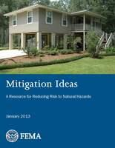
Phase III: Develop a Mitigation Plan
Set planning goals
Review mitigation alternatives
Draft an action plan
Notes:
The mitigation strategy is the “action oriented” part of the plan. It lays out the goals, objectives, and specific actions the District will take to reduce risks.
The goals are general guidelines that explain what the community wants to achieve with the plan.
The mitigation actions are specific projects that help achieve the goals.
The plan describes how the mitigation actions will be implemented, how actions will be prioritized; this includes the roles and responsibilities, funding, and timing information This “plan” also describes how the action will be incorporated into the existing planning mechanisms.
An example goal would be the minimize development in a hazard prone area, the objective would be to reduce the # of water infrastructure structures, like a water tank or pump station in the floodplain, and the action would be to amend the zoning ordinance (if we were in a City planning area) to permit only open spaces in the floodplain.
Example:
Goal: Minimize new development in hazard prone areas.
Objective: Reduce the number of vulnerable structures in flood prone areas.
Action: Amend zoning ordinance to permit only open space uses within floodplains

Slide 26
6) Set Planning Goals – Using the Risk Assessment
Broad statements of what the plan is to achieve
Based on risk
Estimated losses
At-risk facilities and infrastructure (e.g. transportation utility lines?)
At-risk critical facilities
At-risk cultural and natural resources
Goals from other existing plans
Other opportunities
At-risk areas and facilities for future development
Repetitive losses
Public education
Increased insurance coverage
Notes:
For the District’s LHMP, we are going to review various references and sources to develop the District’s mitigation strategy, the strategy is also focused on FEMA’s 6 mitigation project types: prevention, property reduction, natural resource protection, structural projects, public information, and emergency services.
Our HMPC will also review the latest guidance from Cal OES and the Office of Planning and Research, the Adaptation Planning Guide. This guide is currently being updated and the final guide should be adopted this year.

Slide 27
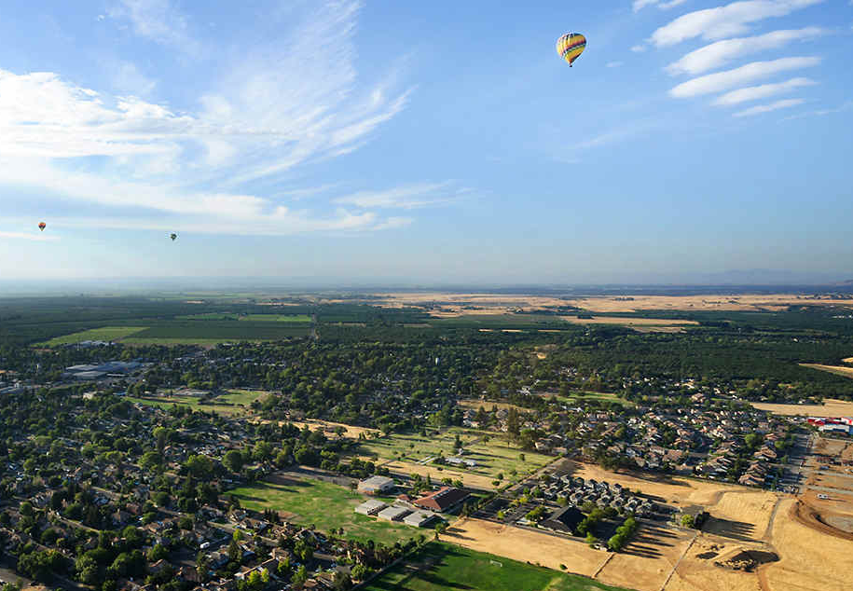
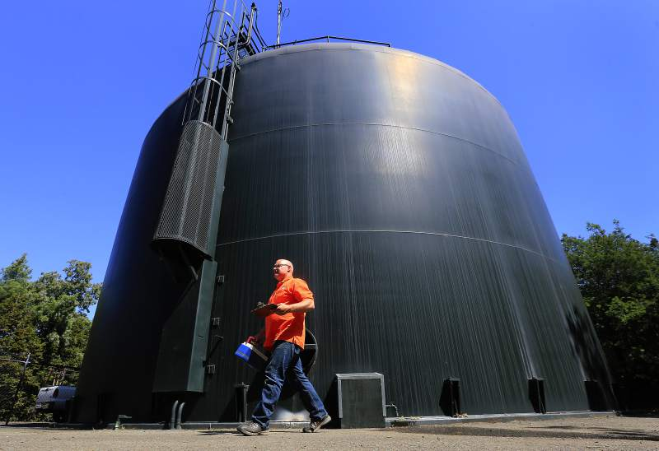
7) Review Mitigation Alternatives
FEMA Mitigation Ideas
NFIP CRS Guidance
Prevention
Property protection
Natural resource protection
Emergency services
Structural projects
Public information
Multi-hazard measures and considerations
Adaptation Planning Guide
Notes:
There are several other key information guides for developing mitigation actions from FEMA, the National Flood Insurance Program, Cal OES, and OPR.

Slide 28
Review of Mitigation Alternatives – Criteria for Selecting Mitigation Measures
Will it work?
Is it cost-beneficial?
Is it affordable?
Is it legal?
Is it fair?
Do people want it?
Are there administrative burdens?
Is it politically acceptable to community leaders?
Is it environmentally sound?
Is funding available?
Example Hazard Mitigation Projects Eligible for FEMA funding:
Wildfire
Defensible space
Hazardous fuels reduction activities (e.g. vegetation removal)
Implement ignition-resistant construction techniques
Flood
Dry and wet flood proofing
Flood reduction projects (e.g. detention ponds, channel stabilization)
Other-General
Utility protection/infrastructure retrofit
Adding generators

Slide 29
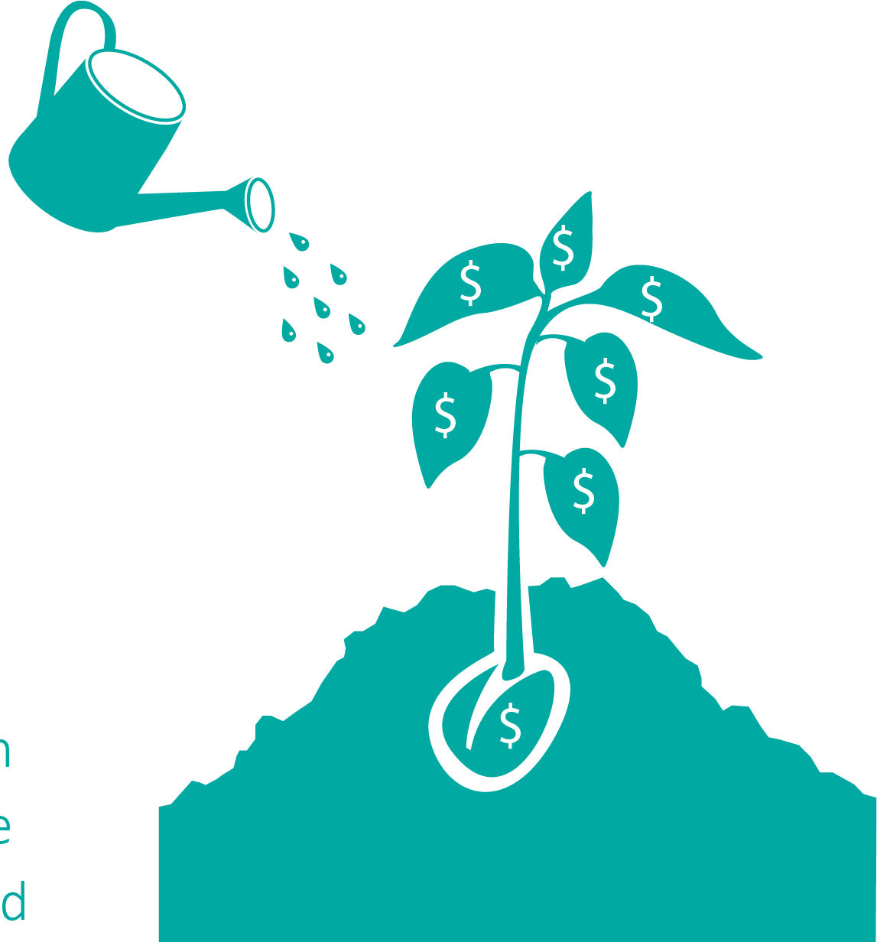
Phase IV: Adopt & Implement the Plan
Adopt the Plan
Public input before adoption
Cal OES review
FEMA Region IX review
Board of Directors adoption
Implement the Plan
Assign an overall project manager
Integrate actions into staff work plans
Monitor changes in vulnerability
Report on progress, publicize successes
Revise the plan as necessary (every 5 years for DMA)

Slide 30
Role of the Hazard Mitigation Planning Committee

Slide 31
Organizational Chart
Valley of the Moon Water District
Christopher Petlock
Hazard Mitigation Planning Committee
District Committee 3 Staff Employees
3 Board Members
Stakeholder Committee
City of Sonoma
Sonoma County
Sonoma Valley Unified School District
Sonoma Water
La Luz Center
Sonoma Valley Fire & Rescue Authority
Hotel Fairmont Sonoma Mission Inn
Project Manager
Juliana Prosperi, AICP
Quality Assurance/Quality Control
Senior Technical Advisor
Scott Field, CEM
Jeff Brislawn, CFM
Technical Resources
Planning Process Jeff Brislawn, CFM
Juliana Prosperi, AICP
Amy Carr
Risk Assessment Mack Chambers
Scott Field, CEM
Amy Carr
Mitigation Strategy Jeff Brislawn, CFM
Juliana Prosperi, AICP
Amy Carr
Notes:
What are the benefits of participation?

Slide 32
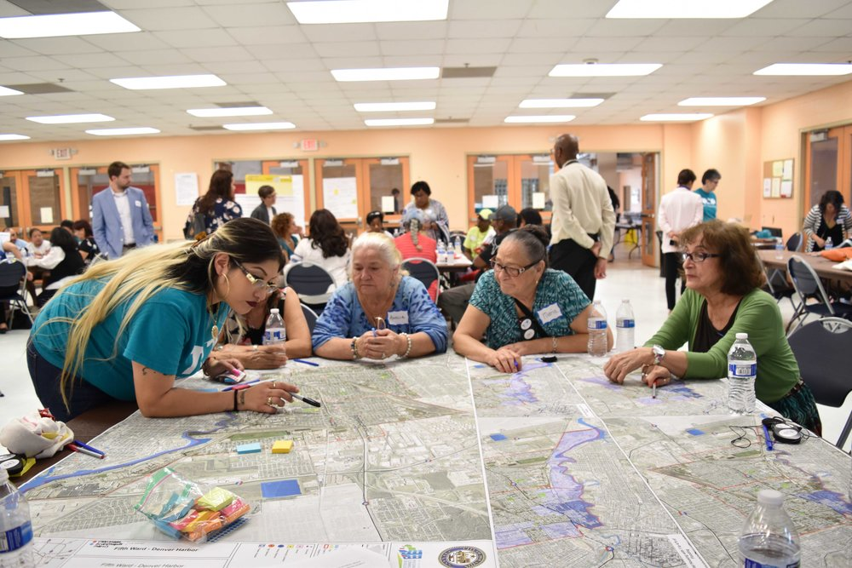
Role of the HMPC and the Benefits
Collaboration on mitigation strategies
Creating eligibility for funding for mitigation projects
Attend meetings and participate in the planning process
Provide requested information
Review drafts and provide comments
Identify mitigation projects
Assist with and participate in the public input process
Coordinate formal adoption by the District Board of Directors
Notes:
What are the benefits of participation?

Slide 33
What goes into the plan?
Section 1 – Introduction
Section 2 – Community Profile
Section 3 – Planning Process
Section 4 – Risk Assessment, plus Capability Assessment
Section 5 – Mitigation Strategy
Section 6 – Plan Adoption
Section 7 – Plan Implementation and Maintenance
Appendices and Annexes

Slide 34
Hazards Review

Slide 35
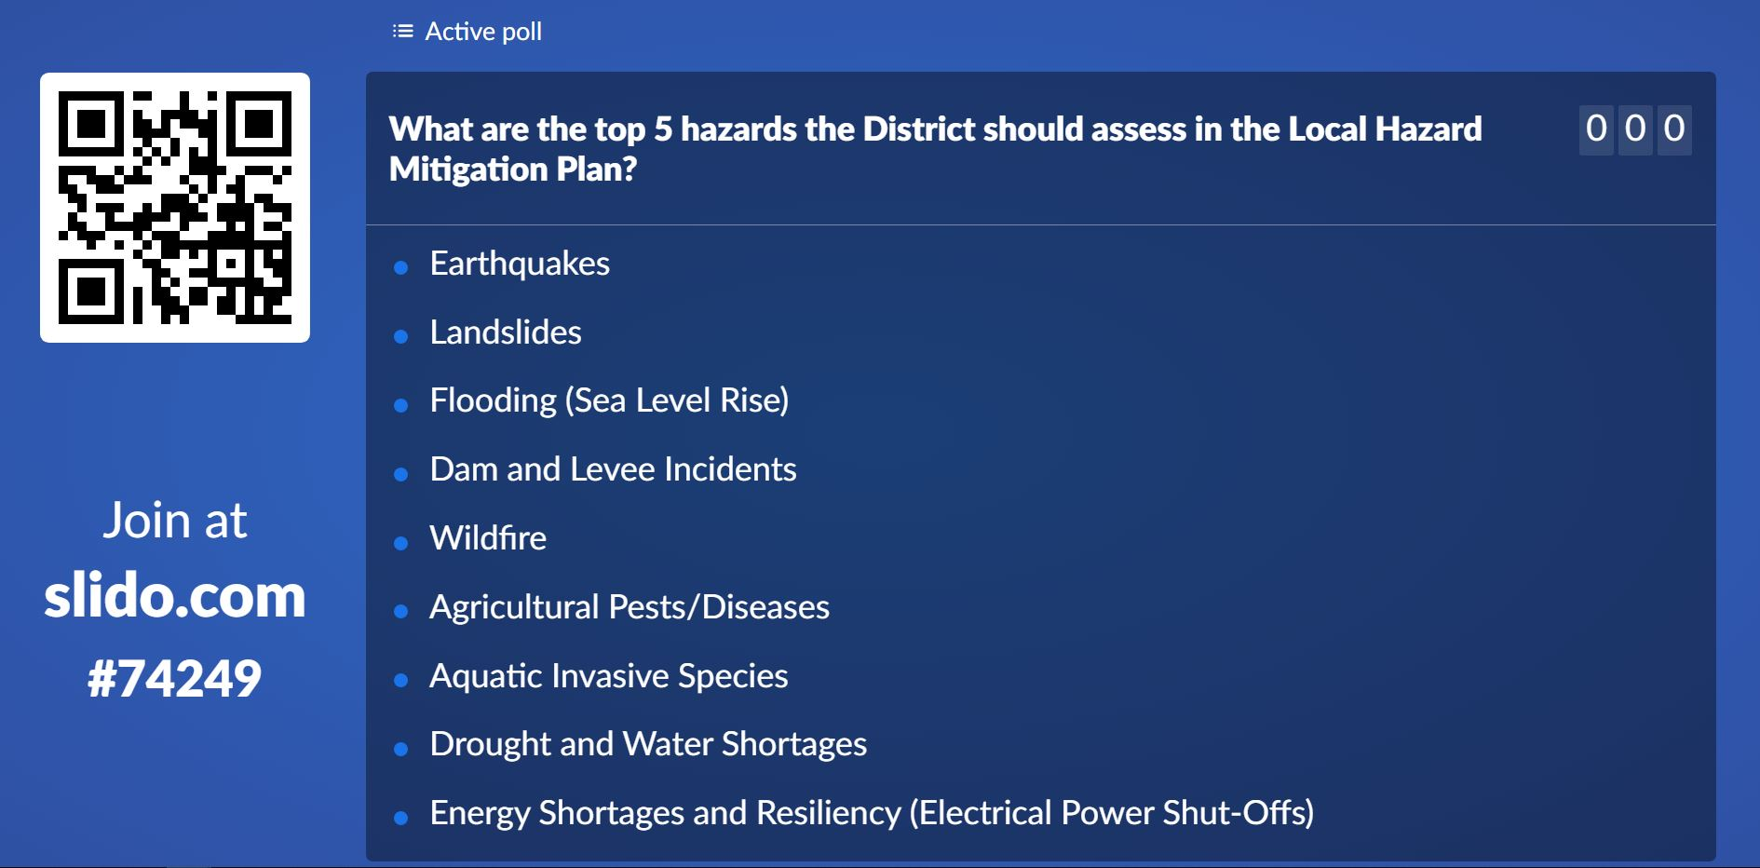
Hazard Poll
Join the poll at: www.slido.com #74249 and complete the poll!
What are the top 5 hazards the District should assess in the Local Hazard Mitigation Plan?

Slide 36
Potential Hazards of Concern
Earthquakes*
Landslides*
Flooding (Sea Level Rise)*
Dam and Levee Incidents
Wildfire*
Agricultural Pests/Diseases
Aquatic Invasive Species
Droughts and Water Shortages*
Energy Shortages and Resiliency (Electrical Power Shut-Offs)
Epidemic/Pandemic/Vector Borne Disease
Extreme Heat
Severe Weather/High Winds
Tree Mortality
Climate Change*
Hazardous Material Releases (Pesticide Use/Groundwater Contamination)
Oil Spills/Natural Gas Pipeline Hazards
Terrorism/Cyber Threats/Civil Disorder
All theses hazards are addressed in 2018 California SHMP
*Hazard addressed in 2016 Sonoma County Operational Area HMP
Notes:
2018 California State HMP – hazards addressed in plan, but likely to be dismissed from District LHMP
Volcano
Tsunami and Seiche Hazards
Air Pollution
Avalanches
Freeze
Radiological Accidents
Train Accidents
Well Stimulation and Hydraulic Fracturing Hazards
2016 Sonoma County Operational Area HMP Update – Appendix D – Climate Change assesses water supply system in County and related drought, groundwater, sea level rise, and climate change impacts
Seismic Hazards
Flood
Wildland Fires
Landslide
Climate Change (addressed in separate Appendix that assesses drought and groundwater availability and sea level rise)

Slide 37
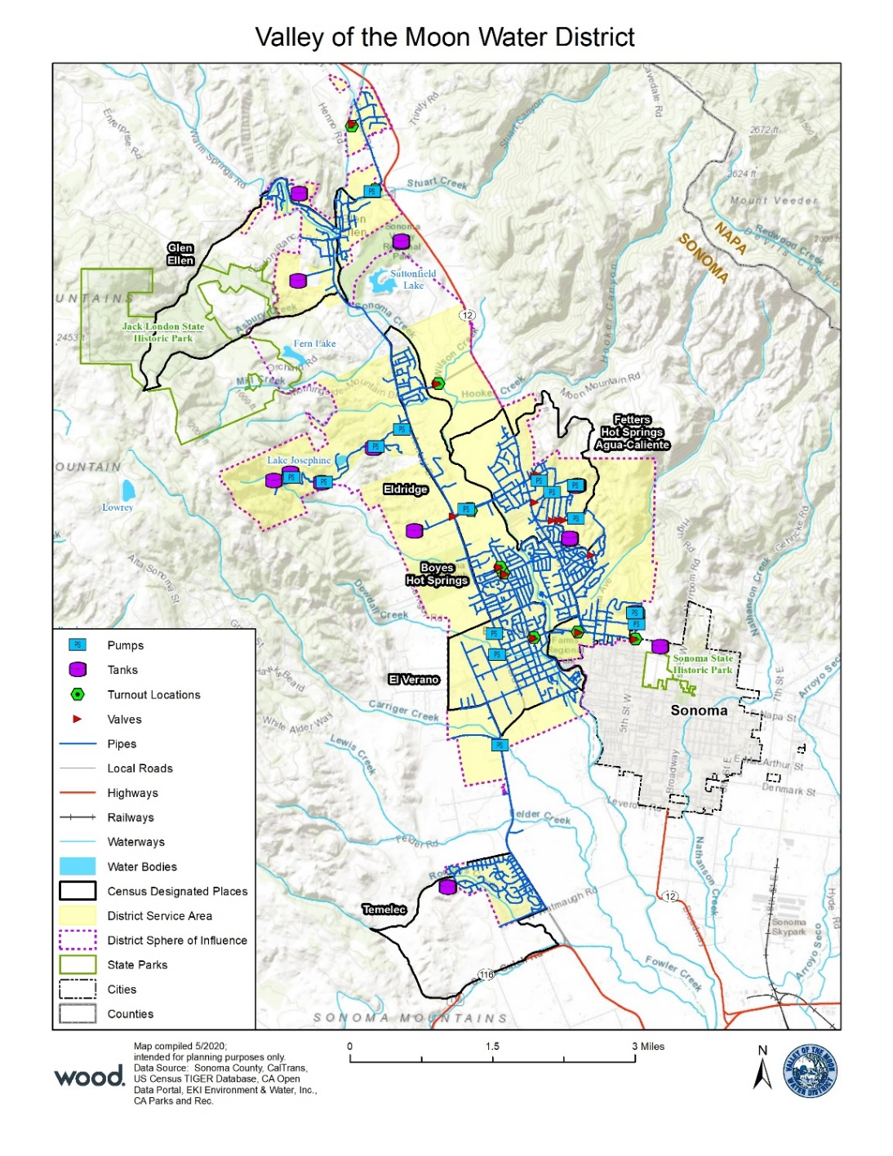
Planning Area

Slide 38
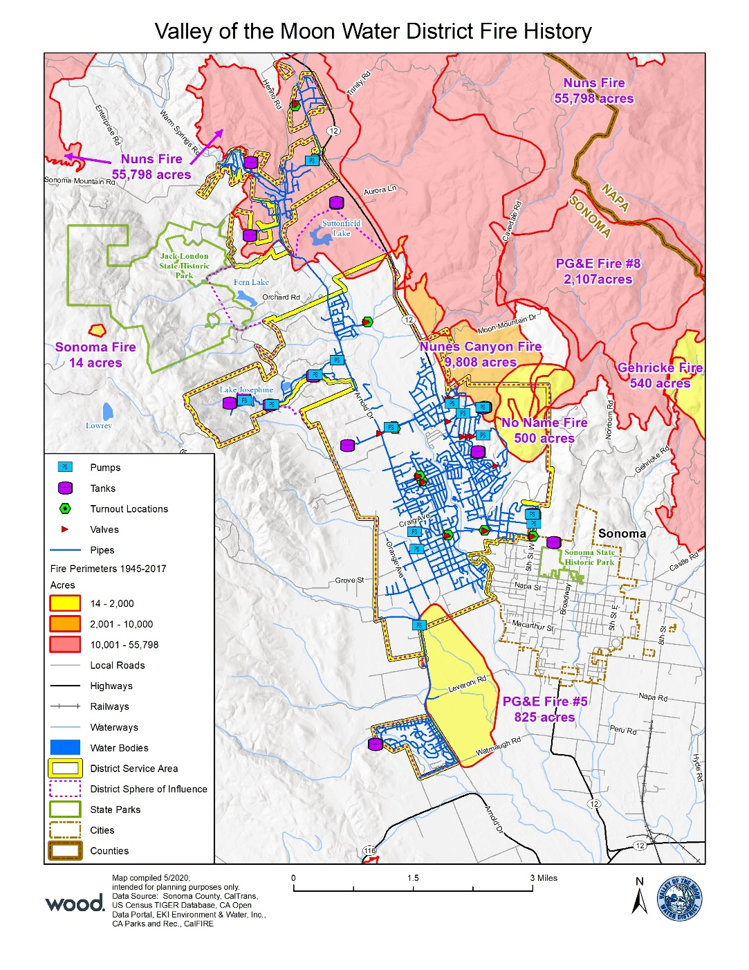
Fire History

Slide 39
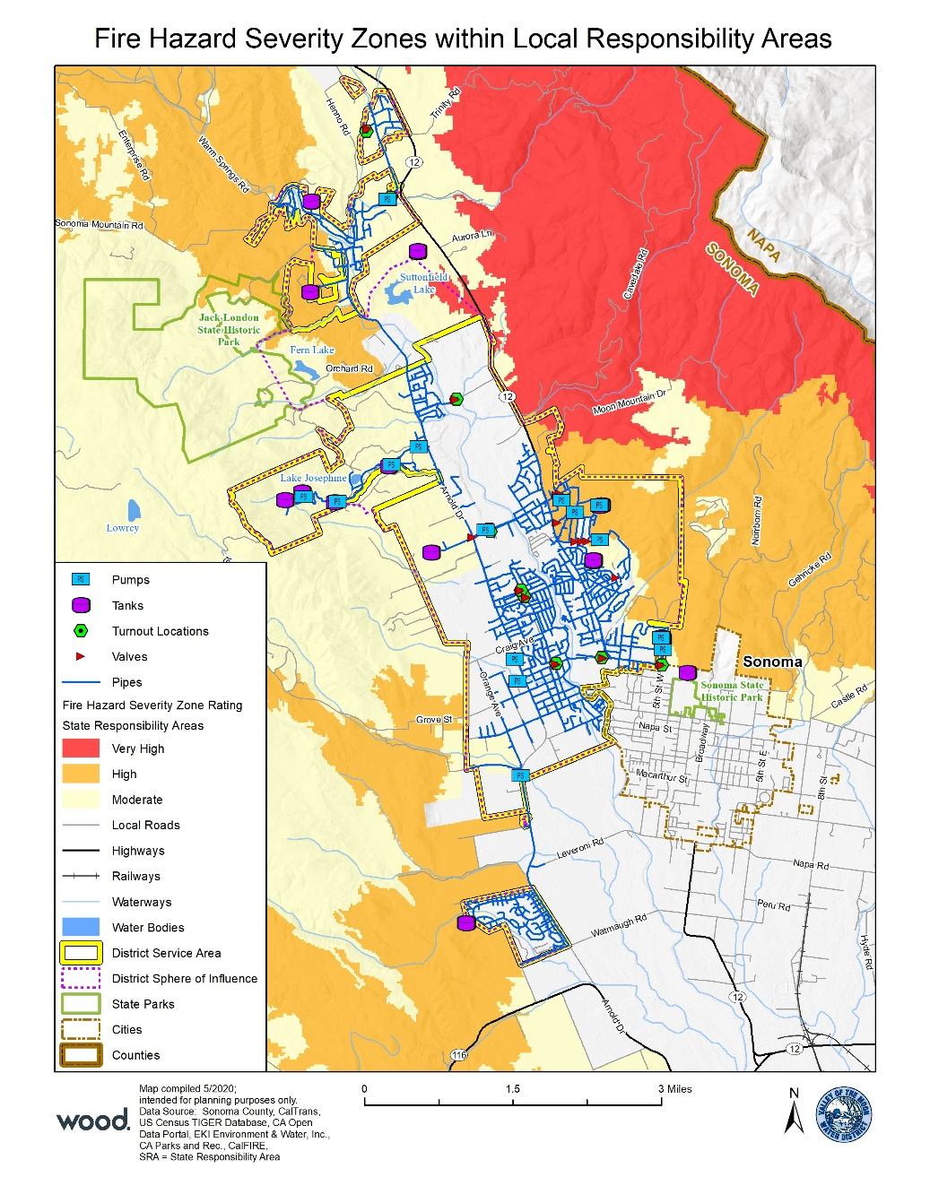
Fire Hazard Severity Zones

Slide 40
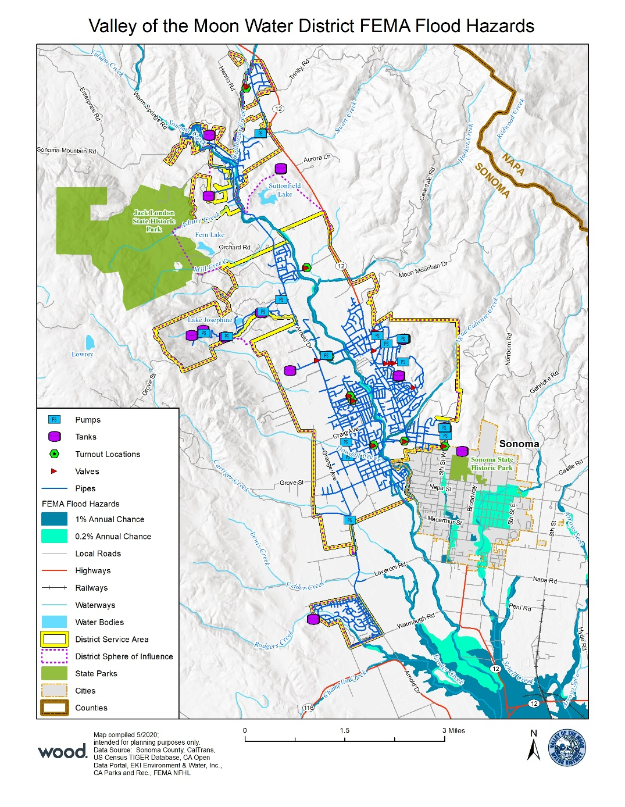
Flood Hazards

Slide 41
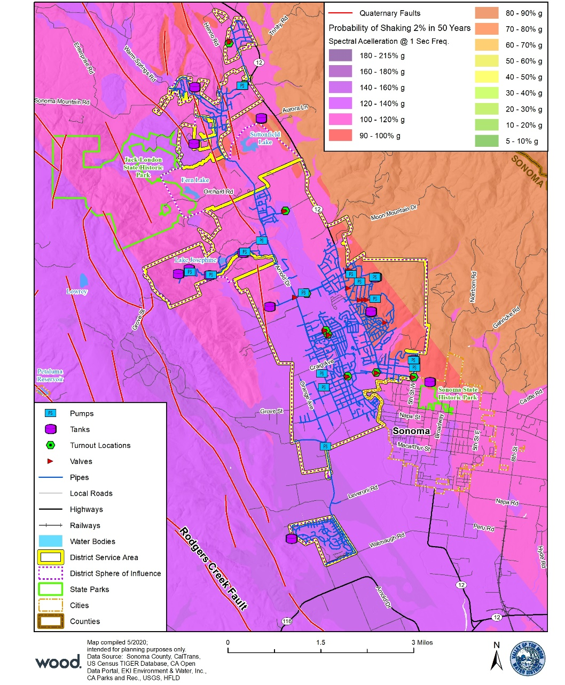
Ground Shaking

Slide 42
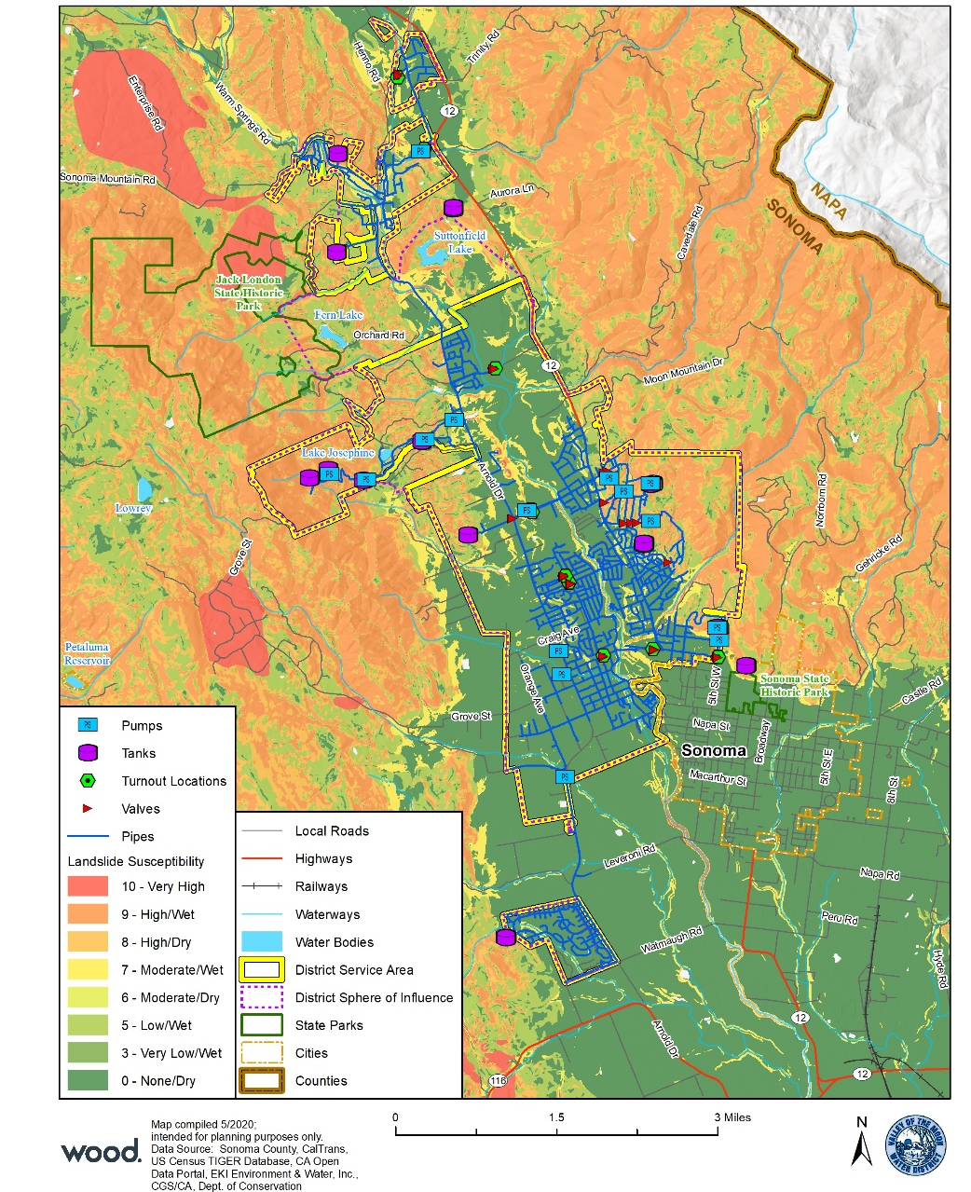
Landslide Susceptibility

Slide 43
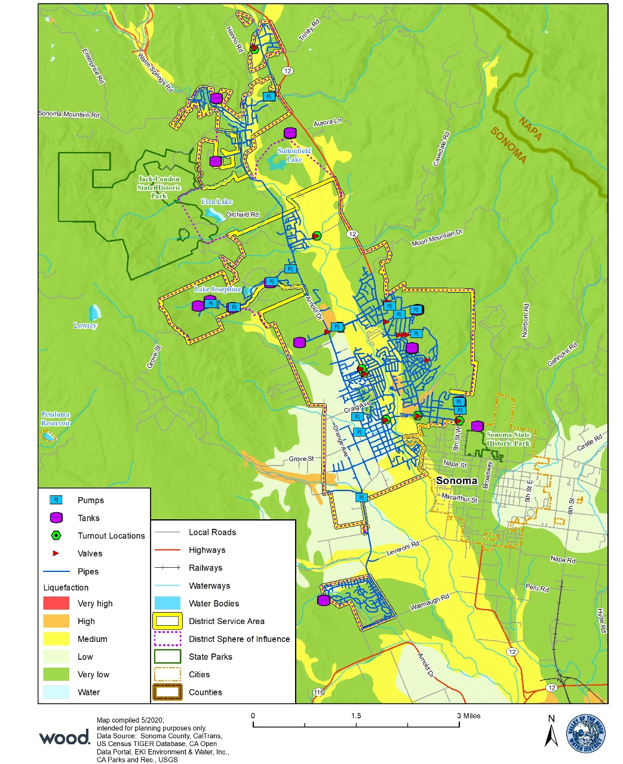
Liquefaction Potential

Slide 44
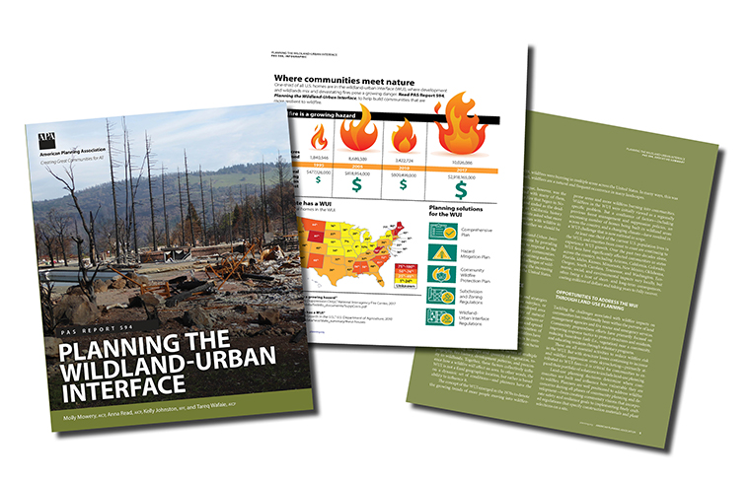
Terminology
Hazard/Threat: Act or phenomenon with potential to do harm
Vulnerability: susceptibility to harm, damage, loss
Exposure: People, property, systems or functions that could be lost to a hazard
Risk: Combines hazard, vulnerability, exposure and probability
Mitigation: Actions taken in advance of a hazard’s impact that reduce its severity

Slide 45
Community Engagement Strategy

Slide 46
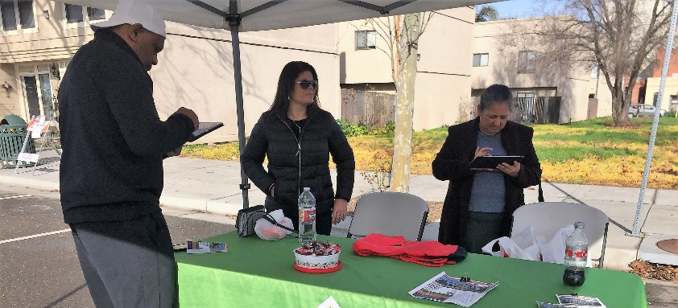
Community Engagement Strategy
Opportunities at scheduled public meetings or events?
Website
Social Media
E-News
Newsletters
Online Public Survey
Pop-Up Events
Translation Services
Public Workshops

Slide 47
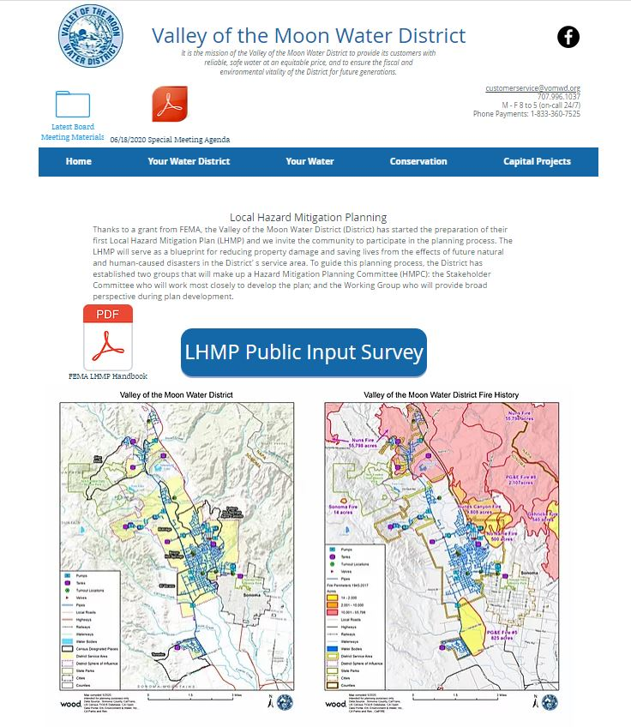
LHMP Webpage

Slide 48
Data Collection Guide

Slide 49
Hazard Information Resources
Valley of the Moon Water District
2019 Water System Master Plan
2019 Water Quality Report
2015 Urban Water Management Plan
Sonoma County
2018-2019 Sonoma County Civil Grand Jury Report
2016 Sonoma County Operational Area HMP Update
2016 Sonoma County Community Wildfire Protection Plan
2014 General Plan 2020 – Public Safety Element
2014 Climate Ready Sonoma County
City of Sonoma
2020 General Plan – Public Safety Element (2006)
Sonoma County Water Agency
2018 Sonoma County Water Agency LHMP
2019 Regional Water Supply Resiliency Study
Sonoma Valley Groundwater Sustainability Agency
Draft Groundwater Sustainability Plan
Notes:
What existing or recent plans, reports or studies exist?
What can we add to this list? What else should be reviewed?
Valley of the Moon Water District
Are there other plans or studies underway we should know about that will inform the LHMP Risk Assessment?
Sonoma County
The County’s HMP Update is underway
The County’s General Plan Update is also underway
Both planning processes can inform the hazards addressed in this plan development
2014 Climate Ready Sonoma County: Climate Hazards and Vulnerabilities assesses climate hazards in County and is a source of information for this plan
City of Sonoma
What plans are being updated at the City?
Will the City be a participating jurisdiction in the County HMP Update?
Sonoma Water
This plan covered: Earthquakes (seismicity, ground shaking, liquefaction, landslides), Flooding, Geologic Hazards, Fire, and Drought
What is the status of the Water Supply Resiliency Study? Work Plan?
Sonoma Valley GSA
Draft GSP is now available; source of background information to inform drought and water shortage hazard profile for District LHMP

Slide 50
Initial Data Needs
GIS Data Needs List
Data Collection Guide
Worksheets #1 Hazard Identification
Worksheet #2 Historic Hazard Event
Worksheet #3 Vulnerability Assessment
Worksheet #4 Capability Assessment
Recent hazard events
Growth and development trends in Sonoma Valley
Recent updated plans and policies
Follow-up with key staff where needed
Notes:
Maximizing the Effectiveness of your Work
Follow a Prescribed Planning Process
Coordinate with ALL other Community Goals and Plans
Seek Diversified Participation and Input (District invited key stakeholders to participate, various business owners and obtained Board input on process)
Ask for Technical Assistance
Establish Partnerships for Implementation

Slide 51
Schedule

Slide 52
When will we meet next?
Submit LHMP to FEMA
FEMA Approval
District Board of Directors Approval
Plan Adoption
Community Workshop
Risk Assessment
HMPC Meeting #2
2nd Administrative Draft LHMP
Draft LHMP
Months 1-2
Months 5-6
Months 9-10
Months 3-4
Months 7-8
Months 11-12
Kick-Off Meeting
Develop Planning Team
Community Engagement Strategy
HMPC Meeting #1
Finalize Goals and Objectives
Develop Mitigation Actions
1st Administrative Draft LHMP
FEMA Region IX Mitigation Plan Review Tool
Cal OES Review
Notes:
Let’s set the date for the HMPC Meeting #2!
This meeting is expected to be scheduled once the Risk Assessment is complete – or by late September!

Slide 53
Detailed Schedule
Task | Anticipated Date
Project Kick-off Meeting | January 14, 2020
Submit HMPC Invite List and Community Engagement Strategy | June 11, 2020
District review Community Engagement Strategy | June 15, 2020
HMPC Meeting #1 | June 25, 2020
Community Workshop | August 4, 2020
Prepare Hazard Identification and Risk Assessment | September 11, 2020
HMPC Meeting #2 | September 22, 2020
Finalize Goals and Objectives | October 2, 2020
HMPC Meeting #3 | November 10, 2020
Compile Mitigation Actions Worksheets | December 11, 2020
Submit 1st Administrative Draft LHMP | January 8, 2021
District provides consolidated comments on 1st Administrative Draft LHMP | February 5, 2021
Complete FEMA Region IX Review Tool | February 12, 2021
Submit 2nd Administrative Draft LHMP | February 26, 2021
Circulate Public Review Draft LHMP (30-day public review) | March 1, 2021 – March 30, 2021
Submit LHMP to Cal OES for review (45-day review) | April 5, 2021
Submit LHMP to FEMA for Review (45-day review)¹ | May 20, 2021
District Board of Directors Hearing¹ | July 6, 2021
*Board of Directors meet the 1st Tuesday of each month.

Slide 54
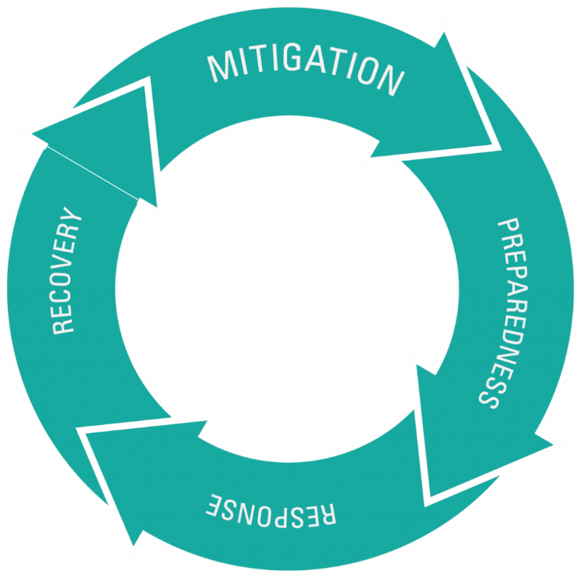
Breaking the Cycle of Disaster Losses
Each time we experience a natural disaster, we learn how to make our people, infrastructure, and environment more resilient.
These events underscore the need to assess and manage risk.
Learning from the past to shape the future and continuing the shift towards mitigation!

Slide 55
Questions?
Juliana Prosperi, AICP
Juliana.Prosperi@woodplc.com
(916) 636-3200
Jeff Brislawn, CFM
Jeff.Brislawn@woodplc.com
(303) 820-4654
Environment & Infrastructure Solutions
https://www.woodplc.com/

